Slide 1





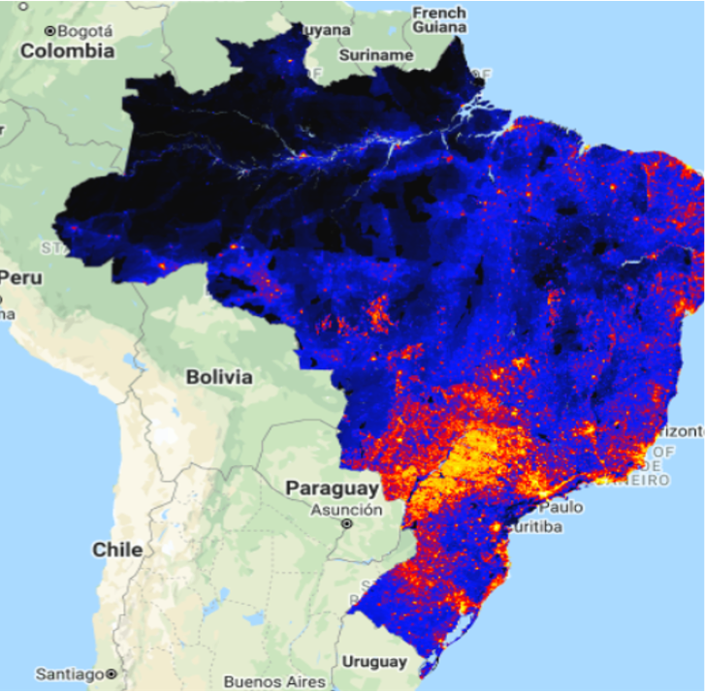








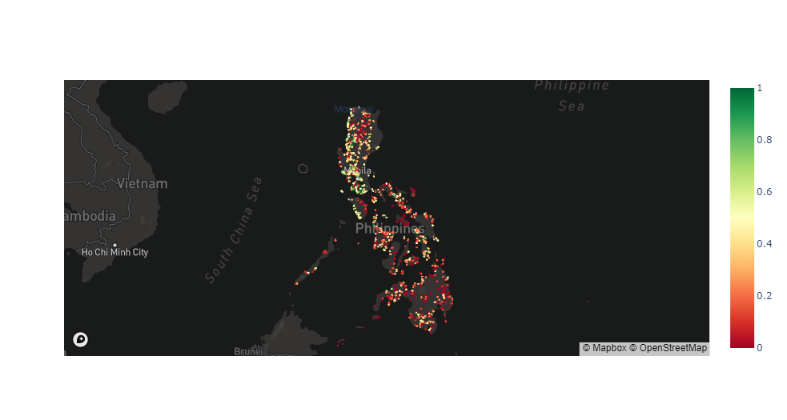






Mapping the World’s Offline Population
Jacob Beck
Fellow
Jonathan Cook
Fellow
Utku Can Öztürk
Fellow
Tova Perlman
Fellow
Robert Hager
Technical Mentor
Daniel Townsend
Project Manager
Background
Regression Model
Discussion
Partner:
The United Nations’ International Telecommunications Union (ITU)
Objective:
To predict the absolute population without Internet access in the local vicinity of any school in the world – we conducted case studies for Brazil, Thailand and the Philippines
We experimented with both regression and binning classification models for the prediction of offline populations
We found performance in the regression task was far better
XGBoost was our best performing model
We utilised a custom evaluation metric that optimises performance for cases where Internet connectivity is < 30%
Global Human Modification Index (shown right) and Monthly Facebook Users were two of our most important predictive features
The Brazilian survey provides connectivity statistics on just 25 thousand households – our model, trained on this data, can be trusted to give connectivity predictions for all 73 million Brazilian households
While our model performs well in new countries with re-training, the errors are higher if one takes the model trained on Brazil and applies it to the Philippines
Problem
40% of the global population still has no Internet access
Less than 1 in 20 school-age children in low income countries have Internet access
Internet inaccessibility drives wealth inequality and hinders opportunity
Results
5% mean absolute error with respect to government survey data achieved on Brazilian schools predicted to have less than 30% connectivity
2% mean absolute error achieved on Philippine schools with model re-training on Philippine survey data
Next Steps
Data Gathering
ITU will continue applying our solutions to different developing nations and use the results to inform policy development.
A natural extension to this project would be to train a multi-national model across multiple countries, which can then include national indicators as predictors
Our work is open sourced on GitHub to help other organizations and institutions better map offline populations
We developed an automatic data gathering package that implements web scraping on any given country to obtain:
Facebook User Estimates
Cell Tower Coverage
Internet
Speeds
Satellite
Imagery
This work was done during the Data Science for Social Good Summer Fellowship at the University of Warwick and LMU

